Slide 1
Lecture 9.3 Hiring: Matching firms and employees

Slide 2
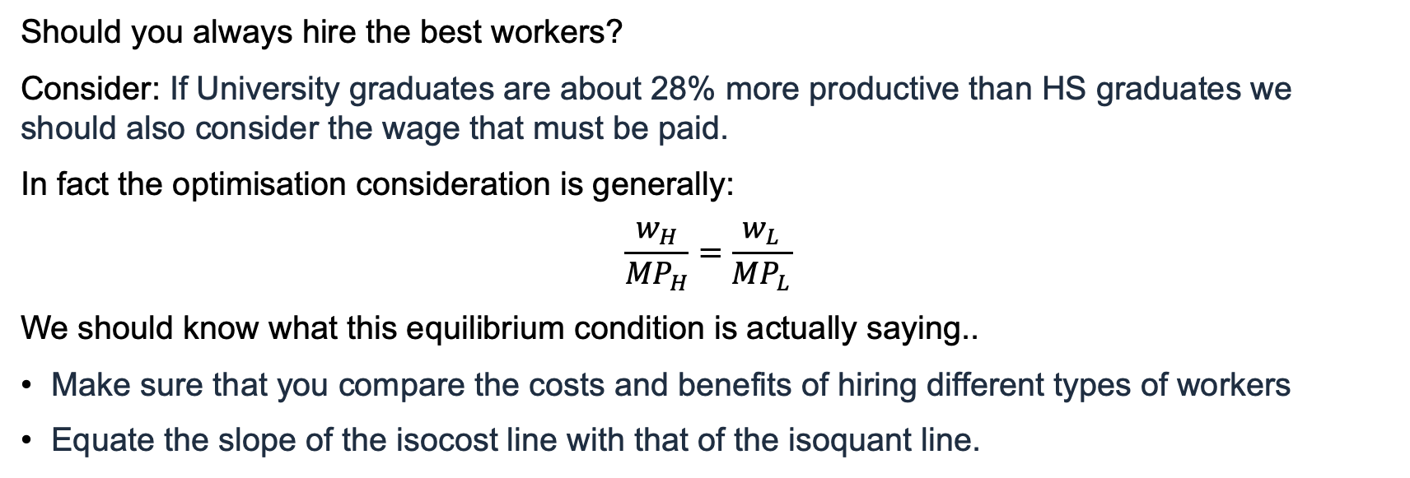
what standards to apply?
Should you always hire the best workers?
Consider: If University graduates are about 28% more productive than HS graduates we should also consider the wage that must be paid.
In fact the optimisation consideration is generally:
$$\frac{w_{H}}{{MP}_{H}}=\frac{w_{L}}{{MP}_{L}}$$
We should know what this equilibrium condition is actually saying..
Make sure that you compare the costs and benefits of hiring different types of workers
Equate the slope of the isocost line with that of the isoquant line.

Slide 3
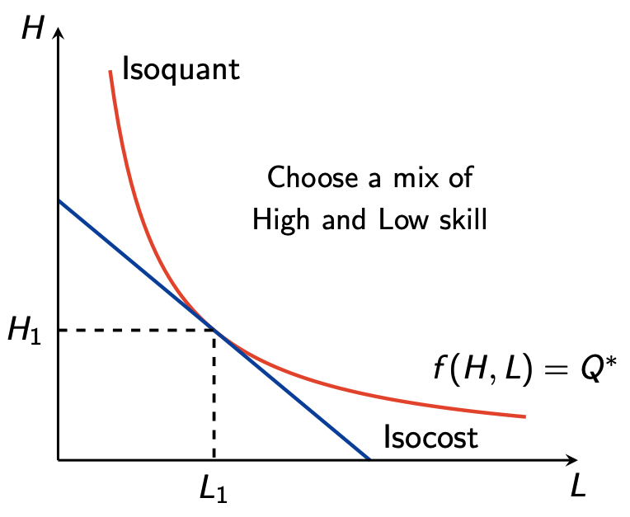
what standards to apply?

Slide 4
what standards to apply?
What mix of ‘high’ and ‘low’ workers to hire needs some considered thought.
One consideration that is likely to be important is the nature of production. We should ask ourselves if:
Productivity is independent of co-workers
Productivity depends on co-workers
Productivity of workers depends on something else (e.g. capital)

Slide 5
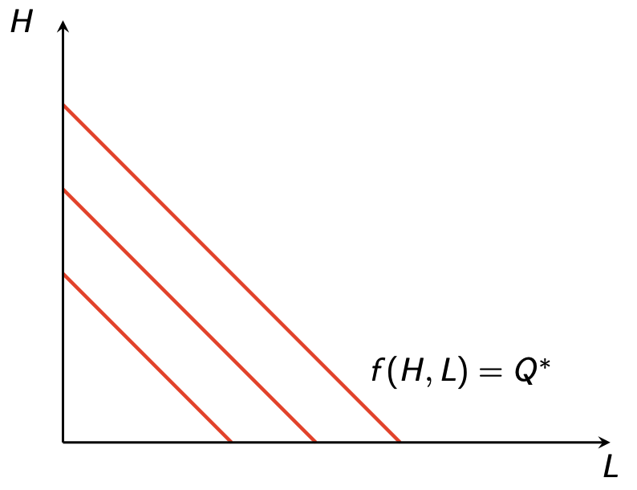
what standards to apply?
What if high and low skill workers are perfect substitutes?

Slide 6
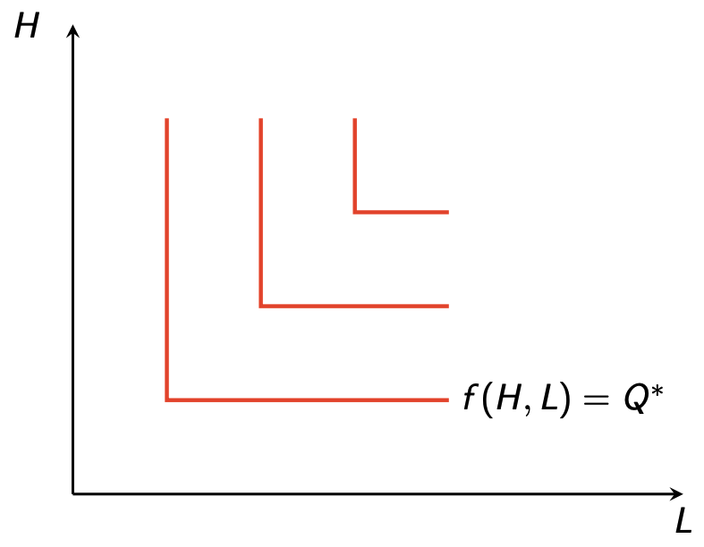
what standards to apply?
What if high and low skill workers are perfect complements?

